Slide 1
OSI MODEL
Open System Interconnection

Slide 2
OSI MODEL
OSI stands for OPEN SYSTEM INTERCONNECTION. It is designed by ISO(International Standard of Organization or International organization for standardization) in 1970s.
OSI was introduced in 1983 by representatives of the major computer and telecom
companies and was adopted by ISO as an international standard in 1984.
An open system is a set of protocols that allows any two different system to communicate regardless of their underlying architecture.

Slide 3
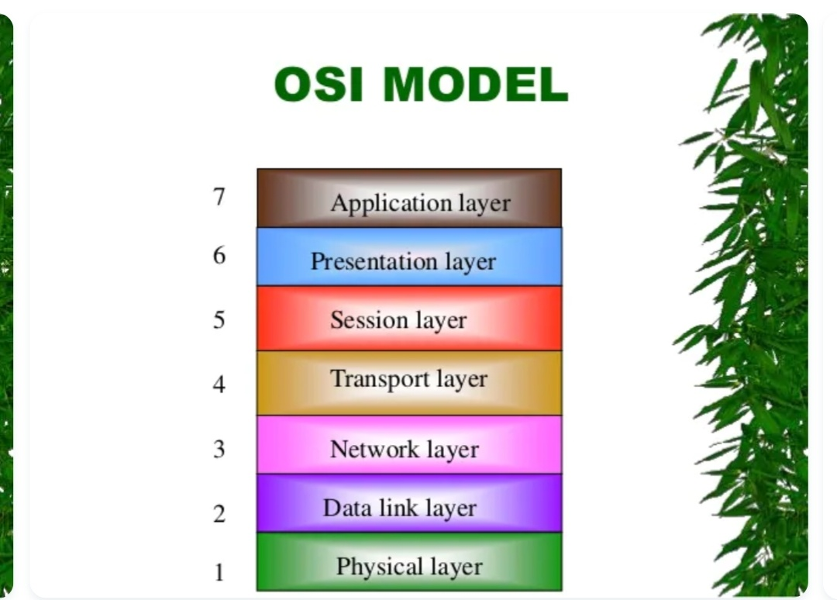
OSI Model

Slide 4
Types of layer
Physical layer
Datalink Layer
Network Layer
Transport layer
Session Layer
Presentation layer
Application Layer

Slide 5
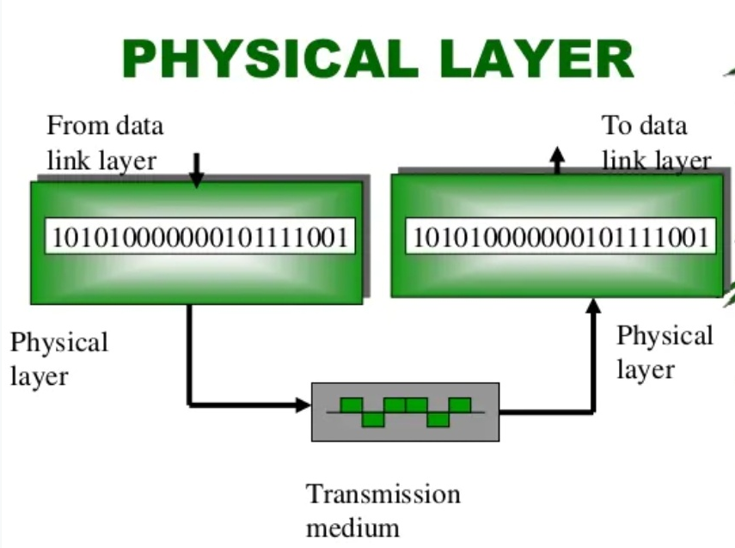
Physical layer
The Physical layer is responsible for transmitting individual bits from one node to the next.
Functions of physical layer:
Representation of bits.
Data Rate.
Synchronization of bits.

Slide 6
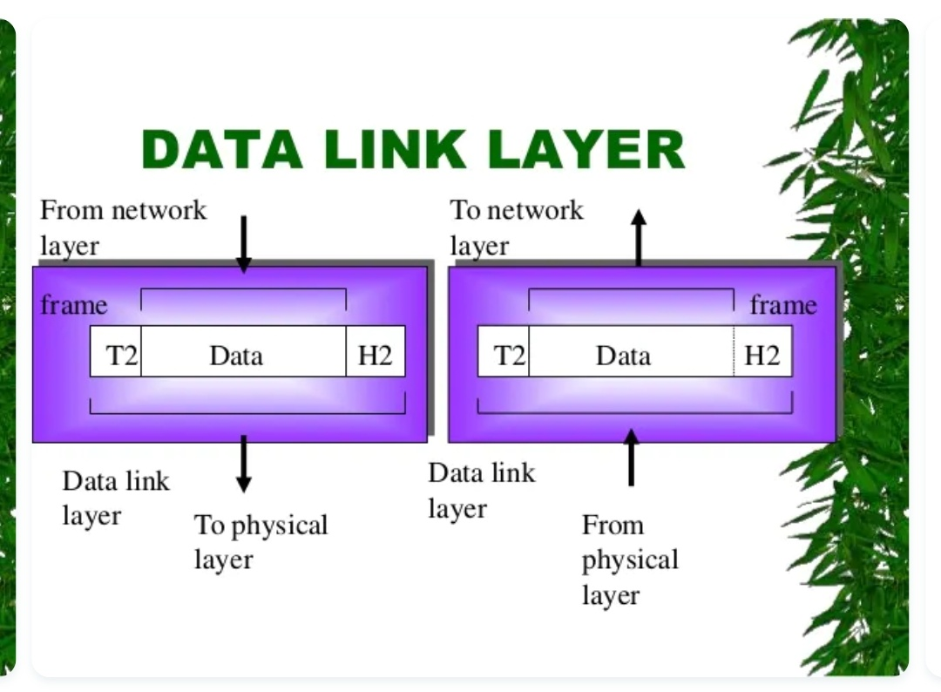
Data link layer
The datalink layer is responsible for transmitting frames from one node to the next.
Functions of Data-link Layer :
Framing
Physical addressing
Flow control
Error control
Access control

Slide 7
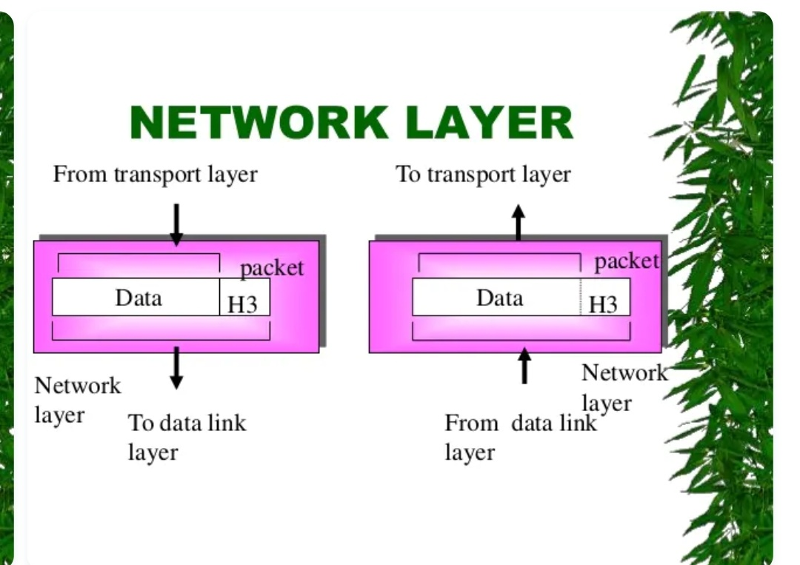
Network layer
The network layer is responsible for the delivery of packets from the original source to the final destination.
Functions of Network Layer:
Local addressing.
Rounting.

Slide 8
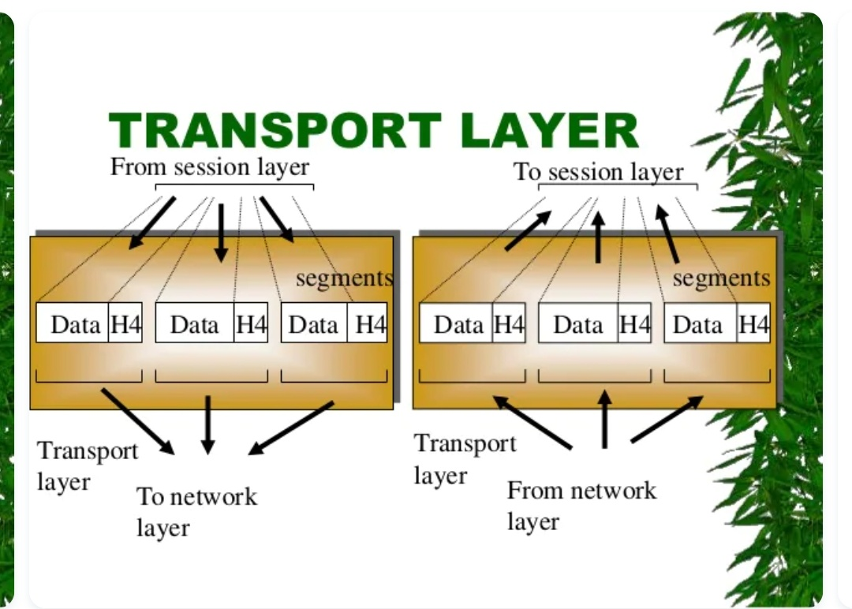
Transport layer
The transport layer is responsible for to delivery of message from one process to another(Process-to-Process delivery).
Functions of Transport layer:
Port Addressing.
Segmentation and reassembly.
Connection control.
Flow & Error control.

Slide 9
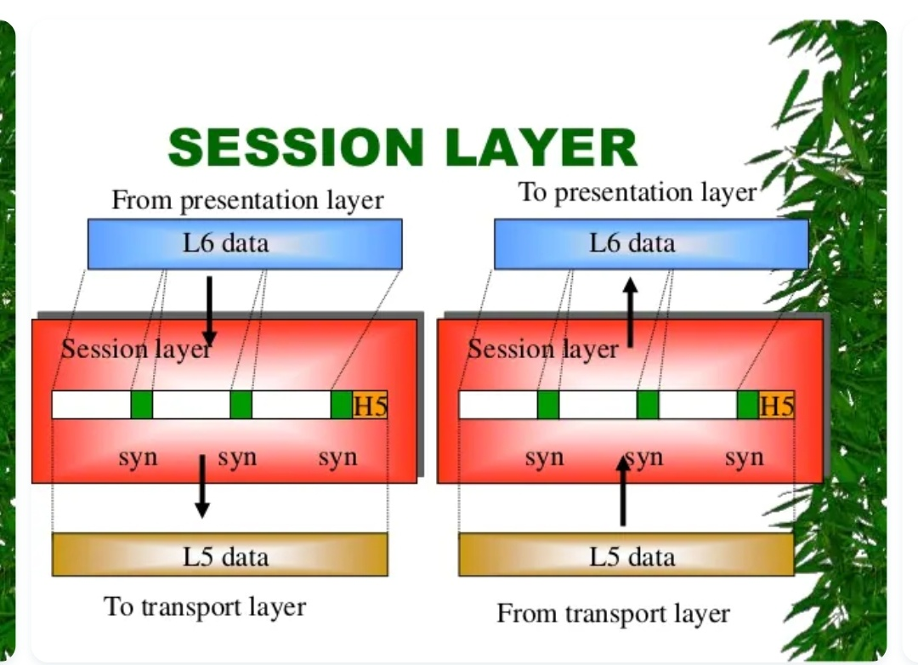
Session layer
This Session layeris the network dialog controller. It established, maintains and synchronizes the interaction between communicating system.
Functions of Session Layer:
Dialog control.
Synchronization.

Slide 10
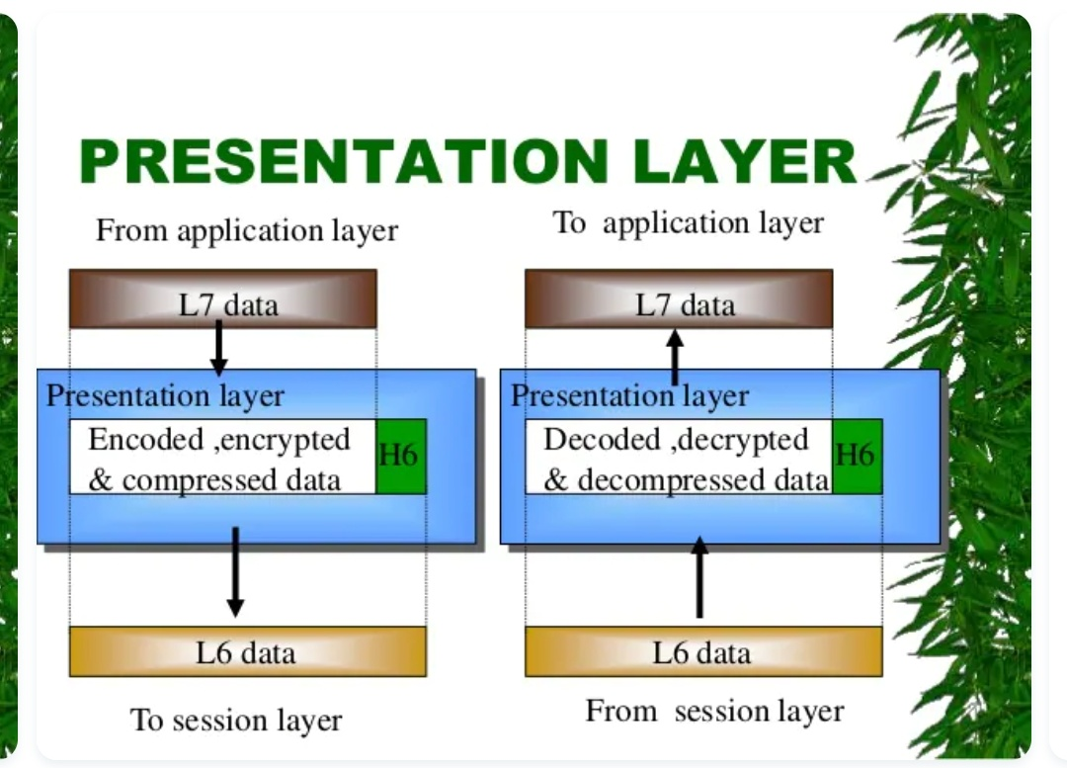
Presentation layer
The presentation layer is concerned with the syntax and semantic of the information exchanged between two system.
Functions of Presentation Layer:
Translation.
Encryption.
Compression (Data compress).

Slide 11
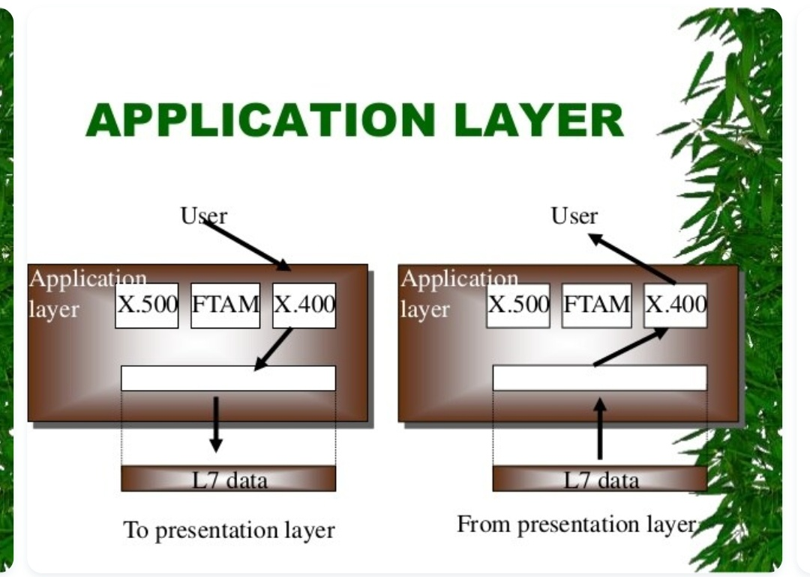
Application layer
The application layer enables the user , whether human or software to access the network. It provides user interfaces and support for services.
Functions of Application layer:
Network virtual terminal.
File transfer access and management(FTAM).

Slide 12
THANK YOU!!

Slide 13
